Slide 1
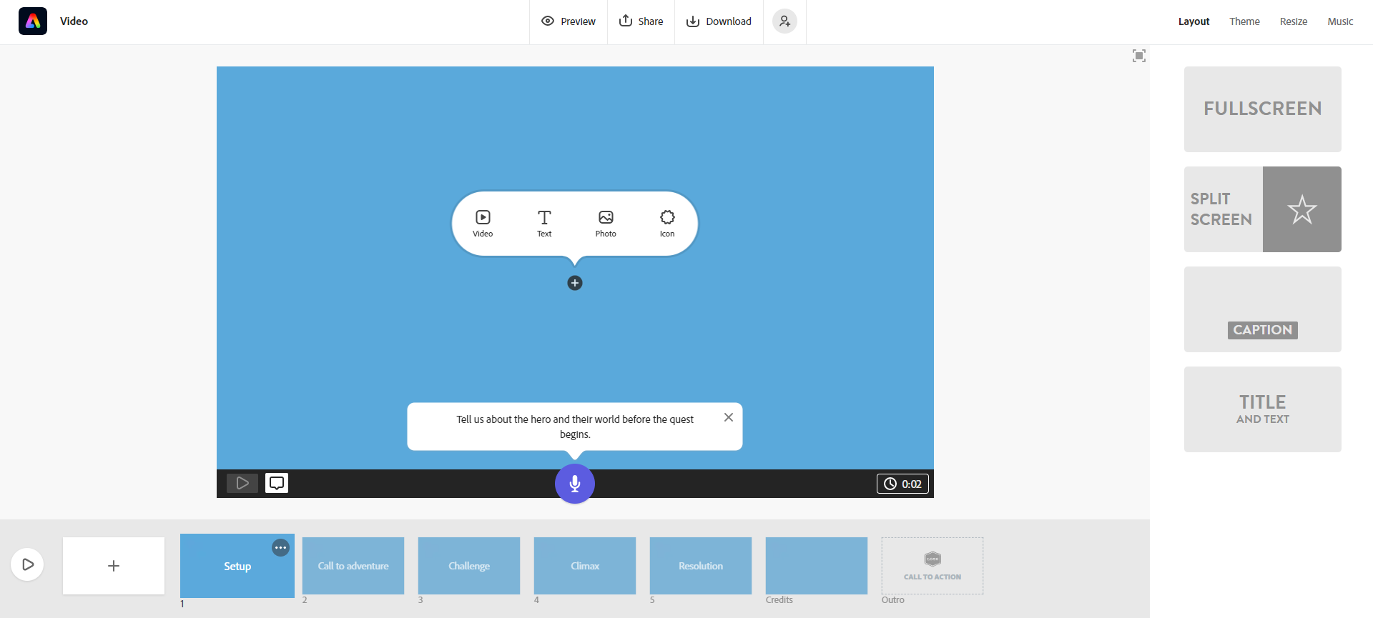
Computing (Adobe SPARK)
Important information
Give your project a name
Share and get link when you have completed the task.
Format options
Create new project
Insert things into your slides
Add your voice by clicking this button
Length of video
Number of slides down the bottom - you can preview your slides

