Slide 1
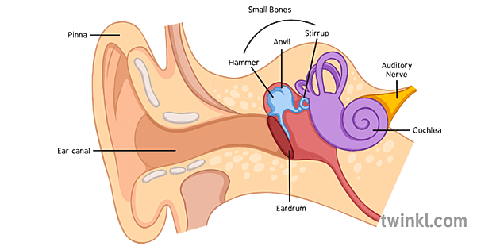
Science (SOUND)
Key Vocabulary
Sound: Sound is a type of energy that travels as vibrations through matter such as air, water, or solids.
Vibration: A rapid back-and-forth movement of a sound source.
Pitch: The highness or lowness of a sound, determined by the frequency of sound waves.
Volume: The loudness or softness of a sound, determined by the amplitude of sound waves
Frequency: The number of sound waves that occur in one second, measured in Hertz (Hz).
Important information
Sound is produced by vibrations.
Sound travels in waves through the air, water and solids.
Sound waves have different frequencies and wavelengths, which determine the pitch and volume of the sound.
The pitch of a sound is how high or low it sounds, while the volume is how loud it is. Decibels (dB) measure the loudness of sound.
Echoes are reflections of sound waves.
The ear is the organ for hearing and can detect sounds within a certain range of frequencies and volumes.
Amplitude: The height of a sound wave, which determines the volume or loudness of the sound.
Ear: The human organ used for hearing.
Decibel (dB): A unit to measure the intensity of sound.
Cochlea: A coiled tube in the inner ear that contains tiny hairs that move in response to sound waves.
Questions to think about
What is sound?
How is sound produced?
What are sound waves?
What determines the pitch and volume of a sound?
How is sound measured?
What is an echo?
How does the ear work?

