Slide 1
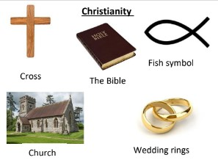
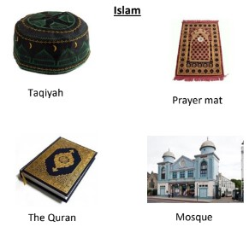
RE – Who am I? What does it mean to belong?
Key Vocabulary
Belonging | A sense of fitting in or feeling like you are an important member of something.
Community | A group of people who have something in common that brings them together.
Symbol | A shape, design or idea, used to represent something.
Christian | People who believe that Jesus was the son of God. They practise Christianity.
Muslim | Someone who believes in Islam and lives according to its rules.
Valuable | A word used to describe someone or something who is important and appreciated.
Ceremony | A formal event such as a wedding, christening or baptism.
Wedding | The act of marrying someone.
Promise | A statement made to a person that says that they will definitely do something or give something.
In this unit we will be exploring the question ‘Who am I and what does it mean to belong?’ We will look at what it means to belong to something and how we show we belong. We will look at belonging to the Christian community as well as exploring the Islamic and Jehovah Witness community. We will be exploring the idea that communities can be religious and non-religious and that we can belong to more than one community at a time.
Questions to think about
Who am I?
What does it mean to belong?
How do people express their identify to show belonging?
Symbols
Communities

