Slide 1
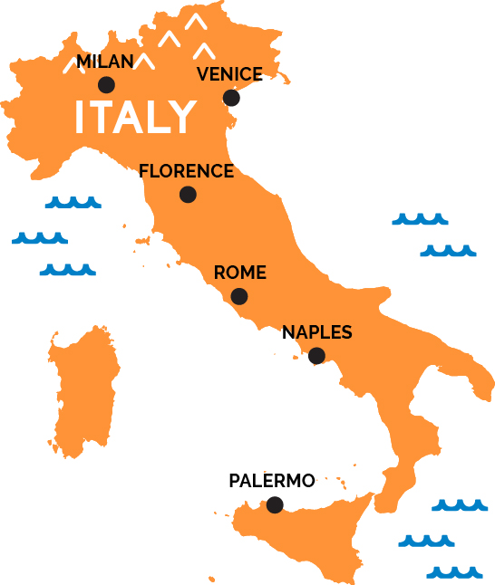
GEOGRAPHY (ITALY)
Key Vocabulary
Peninsula
Mediterranean Sea
Region
Continent
Biome
Climate
Population
Industry
Important information
Human Features:
- Rome (Capital)
- Venice (City of Canals)
- Florence (City of the Renaissance)
- Milan (Fashion City)
- Pisa (Leaning Tower)
- Naples (City of Pizza)
- Italian Language
- Art (Michelangelo, Da Vinci)
Physical Features:
- Appenine Mountains
- Po Valley
- Mount Etna (Active Volcano)
- Tuscan hills
- Lakes (Garda, Como, Maggiore)
- Coastlines (Adriatic, Tyrrhenian, Ionian)
- Islands (Sicily, Sardinia)
Questions to think about
Where is Italy located?
What is the shape of Italy?
Which countries surround Italy?
What are the physical features of Italy?
What are the main cities in Italy?
What are the main attractions in Italy?
What is unique about Italian art?
What is the Italian language?
Why is tourism important to Italy?
References: https://www.bbc.co.uk/bitesize/topics/zyhp34j
- https://www.worldatlas.com/webimage/countrys/europe/itlandst.htm

