Slide 1
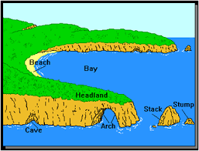
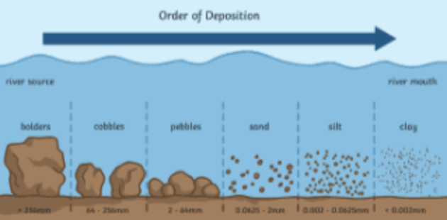
GEOGRAPHY (COASTS)
Key Vocabulary
Coast - Where the land meets the sea
Beach - formed by constructive waves. Sand beaches are flat and wide, shingle are steep and narrow.
Cliff - a mass of rock that rises very high and is almost vertical, or straight up-and-down.
Landslides - a mass movement of material, such as rock, earth or debris, down a slope
Erosion - Waves wear away the coastline
Depositional - Where waves set down material e.g. sand that it has been carrying.
Port - a docking place for ships on the coast of the ocean, a river, or a lake
Headland - an area of resistant rock that extends from the coastline into the sea.
Important information
Coastal areas are constantly changing.
An erosion landform is when areas are worn away by waves and weather conditions. Some examples of an erosion landform is a cave, arch and stack. A dune is not an erosion landform.
A depositional landform is when areas are built up by materials brought in by the sea. An example of a depositional landform is a beach.
There are many different types of coastal management strategies
For example, sea walls, revetments,
gabions and groynes.
Questions to think about
Can you explain how water and weather can change the landscape?
Can you describe how coastal features are formed?
Can you explain how and why landscapes change over time?
How do physical factors change the landscape in the future?
How do human factors change the landscape in the future?

